Slide 1
Insight from the 2018 Healthcare Recruitment Metrics Benchmark Study Results and Elite Honor Roll Recruitment Winner
Transform Your Recruitment Strategy
SPEAKERS:
Dana Cates
Senior Consultant,
Lean Human Capital by HealthcareSource
Nick Watts
Vice President of Talent & Workforce Optimization
SCL Health
Notes:
Hello and welcome everyone! And thanks for taking time out of your very busy day to join us today.

Slide 2

Dana Cates
About
30 years of Human Resources practitioner and leadership experience, working in the telecommunications, logistics and healthcare industries.
The last 14 years focused on Talent Acquisition and Workforce Planning in the Healthcare.
Has provided TA Leadership for St. Joseph Health System and Children’s Healthcare of Atlanta.
Most recently, Director of Talent Acquisition and Workforce Planning at Texas Health Resources.
At Texas Health, instrumental in many process improvement initiatives which led to becoming a 5-time LHC Elite Honor Roll winner.
Being certified as a Senior Professional in Human Resources (SPHR), Strategic Workforce Planner (SWP) and Recruiter Academy Certified Recruiter (RACR), brings a wealth of experience to LHC as a Sr. Consultant.

Slide 3
Labor Market — Openings vs. Hires
33% of hospitals currently have a vacancy rate of greater than 10%
Healthcare segment is adding 230,000 new jobs annually through 2024
The average recruiter is carrying 49% more workload than optimal
Bureau of Labor Statistics
Notes:
So the big picture here is pretty bleak. First, the talent gaps we’re seeing are trending worse. In this chart you can see monthly healthcare hires vs. openings as reported by the bureau of labor statistics. As you can see hiring is relatively flat while openings are exploding. If we color code raw openings against raw hires, you can see how big the gap is. Anything grey didn’t get filled. As you can see, it’s trending in the wrong direction. We’re at a point where the number of openings each month are almost double the number of hires.
Sources:
Vacancy rate data is from here: : http://www.nsinursingsolutions.com/Files/assets/library/retention-institute/NationalHealthcareRNRetentionReport2016.pdf
And this same source is where I derived the overall turnover and bedside nursing numbers. Our LHC numbers are lower than this, but that’s a good thing because it’s because we’re helping them – so I didn’t use our own data in this case because it’s a biased population.
Avg recruiter workload and time to fill over 60 days is from LHC.
All graphs come from BLS data:
Openings vs. Hires are derived from these two data sets:
JTS62000000JOL for Openings
JTS62000000HIL for Hires
I added coloring to first graph – screen shot and then pulled into Paint.net but that was the only change, data is straight from the BLS download.
On the second graph, this is the just the delta between Openings and Hires – effectively Unfilled Positions each month.
Quits numbers are derived from these two data sets:
LNU04034239 for Unemployment
JTU62000000QUL for Quits
As an additional data point, Robert Wood Johnson Foundation at pegs first year, first job turnover for new nursing grads at 17.5% and at two years it’s 33.5%!

Slide 4

Transformation
The Pain of the Same is Greater than the Pain of Change

Slide 5
Investment Comparison by Industry
Investment is down by an average of $200 per hire or 0.8% investment ratio from 2017 . Healthcare’s investment in recruitment continues to lag other industries by $4600 per hire or 12.5% overall

Slide 6
Healthcare Recruitment Metrics Benchmark Study
The Data Foundation
Spanning 6 Key Performance Dimensions of Recruiting
UNDERSTAND YOUR PERFORMANCE
In Real,
Meaningful Metrics
Relative to
Your Peers
Quarter-to-Quarter
and Year-to-Year
1100+ hospitals have participated over the last 9 years

Slide 7





































Lean Human Capital Community

Slide 8
The Dimensions of Performance
RESPONSIVENESS
QUALITY
OF HIRE
PRODUCTIVITY
QUALITY
OF SERVICE
EFFICIENCY
COST
Time-to-Fill Metrics Spanning Multiple Roles, Segmented by <60 days>
Various Ratios — Applications
to Positions
Filled / Offers/
Candidates Considered
90/365 Day Turnover for
New Hires; Breakdowns for FT/PT/Contingent
Vacancy Rates, Positions Filled per Recruitment
FTE, Employee Referral %
Cost-per-Hire
and Recruitment Cost Ratio
Hiring Managers, Successful and Unsuccessful Candidates
Total Benchmark Data Set: 523 recruitment metrics across 12 unique job families

Slide 9



A Balanced Scorecard
A Balanced Performance Scorecard
will allow you to...
Allows you to …..
  Celebrate Success!
  Drive Performance Improvement.
  Quantify Return on Investment to Key Stakeholders based on their strategic initiatives.
Notes:
NOTES

Slide 10
Overview – 2018 Benchmark Study
9th Year of Study - Over 1,100 hospitals from 250+ different health systems.
Data Broken down by Size of Organization:
  Small: 0-5000 FTE employees
  Medium: 5001-13,999
  Large: 14,000 +
1,046,670 FTE employees (24% increase)!
Processed over 7.2 million applicants.
Routed over 1.2 million candidates to hiring managers.
Filled over 297K positions.
39% are academic/teaching facilities.
49% have achieved Magnet status.

Slide 11
Time to Fill
What are the trends?
Finally beginning to see a decrease in time to fill.
Benchmark Year | All Positions Median | Direct Care RN Median
2015 | 45 | 45
2016 | 47 | 52
2017 | 54 | 59
2018 | 50 | 53

Slide 12
Breakdown of Under/Over 60 Days Time to Fill
Another Improvement over Previous Year
2017
71% < 60 Days
29% ≥ 60 Days
Avg TTF
54 days
24 Days
125 Days
2018
72% < 60 Days
28% ≥ 60 Days
Avg TTF
50 days
23 Days
124 Days

Slide 13
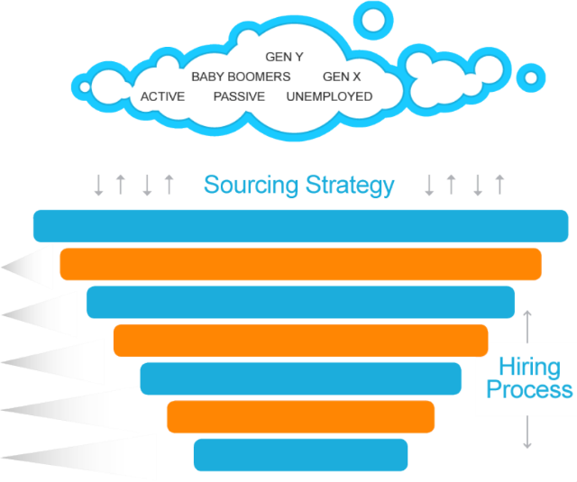
Staffing Process Efficiency
WASTE!
Unqualified Candidates!
Decrease by 14% from 2017
NUMBER OF APPLICATIONS
18 to 1
CANDIDATES ROUTED
FOR CONSIDERATION
Increase by 17% from 2017
5.5 to 1
Wait Time!
OFFERS
Decrease by 1% from 2017
90%
HIRES

Slide 14
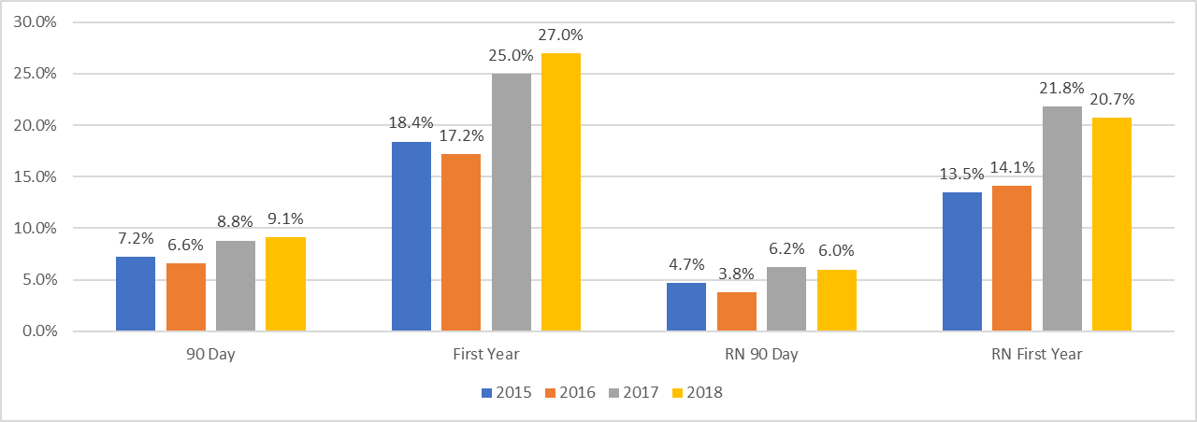
Quality of Hire/Turnover
Turnover continues to rise, but stabilizes for Direct Care RN’s

Slide 15
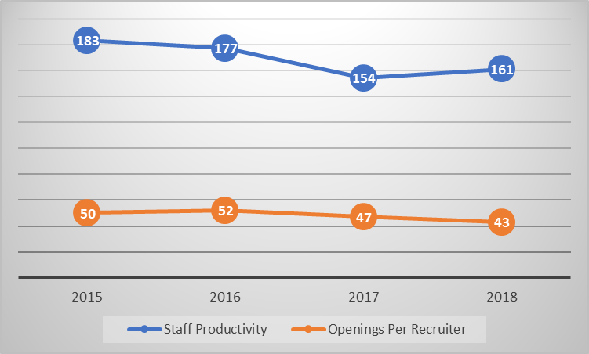
Productivity
Productivity |  | Low (Not Good) | Optimum (Healthy) | High (Not Good)
Staff Productivity (Positions filled / Staff FTE) |  | 100 | 115 | 130
Openings per Recruiter |  | 20 | 35 | 50
NOTE: When staff productivity and openings per recruiter hits “high” levels, it negatively impacts speed, quality of service, quality of hire, cost and efficiency.

Slide 16

How to Hire – Chances Are You’re Doing It All Wrong
“The process requires probing beneath the surface of people and their resumes; engaging managers in every aspect of hiring; treating your in-house recruiters as true business partners; adopting a mindset in which you’re always recruiting …”
Patty McCord
Chief Talent Officer, NETFLIX

Slide 17
Quality of Service – Voice of Customer
HMART^{sm} YoY Improvement
New Hire YoY Improvement
Aggressive action plans for improvement have significantly Impacted growth!

Slide 18
In summary:
Compelling Findings in the Benchmark Data Study
Organizations that have embarked on their Transformation Journey, using Lean principals is one of the key drivers in the TTF and Turnover rated to remain the same or improve.
Be careful comparing yourself to the median benchmarks. There is a large separation that is happening between those that continue to do the same things and those that have embarked on a TJ.
We categorize organizations a 0.0, 1.0, 2.0 and 3.0.
  0.0 – Have not considered embarking on a TJ
  1.0 – Made the decision to embark on TJ. Baselining performance and building Action plan.
  2.0 – 1 year +/- into Journey
  3.0 – 2+ years into a SUCCESSFUL Journey
3.0 Organizations are seeing outstanding results!
    Overall 90 day TO rate is 4.8%. 0.0 and 1.0 clients – 7.5%!
    Positions filled from offers extended (close ratio/efficiency) – 91.9% versus 83.6% for 0 and 1.
    Average TTF – 68 days for 0 and 1 versus 43 for 3.0!
    With a mature sourcing organization, TTF for positions filled in over 60 days (CDVs) is 30 days faster! 144 to 114.
    Are investing more in professional recruiters and sourcers. 55 for 0 and 1 versus 36 for 3.0
    use data/fact to quantify ROI. They have recruitment teams passionate about Continuous improvement an lifelong learning.
We expect further separation between the low 25% and Top 25% in the coming years as supply/demand for talent gets worse.

Slide 19
Transformation
The Pain of the Same is Greater than the Pain of Change

Slide 20
The framework of a successful business plan to secure investment

Slide 21
Business Plan Must Haves
Market Analysis
Current
Desired
Staffing Optimization Analysis
Current
Desired
ROI of Funding Request
Current
Desired
Reqs per Recruiter Benchmark
Balancing of Openings per recruiter
Understand conceptually but lack the tools and data to build data driven analysis
Investment per Hire across industries
Hiring Demand by job family
Cost Savings of just one sourcer
OPTIMUM number of Reqs per Recruiter
Competitive landscape
Sourcing / Pre-Screen by job family time study
Basic workforce planning analysis
Productivity Industry Benchmarks
Cost of Vacancy
Cost of Turnover
Customer Satisfaction
Candidate Experience

Slide 22
Align Healthcare and Recruitment
Strategic Objectives
Health System
Recruitment
HCAHPS
(Patient Satisfaction)
Clinical Outcomes
(Results of any Healthcare Intervention)
Voice of Customer
(Hiring Manager, New Hire, Non-Hired)
Performance Outcomes (Speed/Efficiency/Quality/Productivity/Cost)
Clinical Protocols
(Set of Rules Followed by Providers)
Standard Operating Procedure
(Established Methods to be Followed Routinely)
Evidence Based Practice
(Current best evidence in making decisions
about patient care)
Best Practice Recommendations
(A procedure that has been shown by research
and experience to produce optimal results)
Alignment and Presentation is Priceless ☺!
Notes:
NOTES

Slide 23

2017 Honorees
Mercy Health, a member of Trinity Health – West Michigan
  1st time honoree
Providence St. Joseph Health & Services
  2nd time honoree
SCL Health
  2nd time honoree

Slide 24


Introduction – Nick Watts
Joined SCL Health in February 2014
Serves as Vice President of Talent & Workforce Optimization
Responsible for setting the strategic vision for how the organization will attract and acquire talent
Additionally, focused on supporting the talent development and engagement strategies to promote a highly engaged culture
Prior to SCL Health, held recruitment positions at both Henry Ford Health System and Beaumont Health.
Earned a master’s degree in human resources administration and a bachelor’s degree in business administration both from Central Michigan University

Slide 25

Introduction – Organization
SCL Health is a faith-based, nonprofit healthcare organization dedicated to improving the health of the people and communities we serve, especially those who are poor and vulnerable
Founded by the Sisters of Charity of Leavenworth in 1864, the $2.6 billion health network provides comprehensive, coordinated care through 10 hospitals, more than 100 physician clinics, and home health, hospice, mental health and safety-net services primarily in Colorado and Montana
We relentlessly focus on delivering safe, high-quality, effective care to every patient, every time, everywhere
In 2016, SCL Health invested $257 million in community benefit —10 cents of every dollar we earn—to support health improvement in our communities
We proudly partner with other organizations to improve quality and the patient experience.
Our story starts with the Sisters of Charity of Leavenworth, who opened their first hospital in 1864.

Slide 26
Metric: Number of hires per month
How it is used: Utilized to track productivity within the Recruiter Team. This metric shows a Recruiters ability to manage their requisitions, priorities and hiring managers to open and close requisitions quickly.
Intent: Inspire and drive performance within the Recruiters
How we implemented: Automated reports from our Applicant Tracking System are sent to our Leadership Team. The Leaders review and include this in their weekly update email which includes recognition for the top performers from the prior week

Slide 27
Reporting Sample
Recruiter | Ave Monthly Total | YTD Total | 4 Week Total | Last 7 Days
Recruiter 1 | 50 | 200 | 60 | 10
Recruiter 2 | 45 | 185 | 50 | 9
Recruiter 3 | 40 | 165 | 40 | 8
Recruiter 4 | 35 | 145 | 30 | 7
Site | Ave Monthly Total | YTD Total | 4 Week Total | Last 7 Days
Location 1 | 50 | 200 | 60 | 10
Location 2 | 45 | 185 | 50 | 9
Location 3 | 40 | 165 | 40 | 8
Location 4 | 35 | 145 | 30 | 7

Slide 28
Metric: Openings Per Recruiter
How it is used: Openings per Recruiter is used to track balance within the Recruiter Team. We strive for a balance of 40 – 60 active requisitions per Recruiter. This gives them the ability to phone screen candidates, source if needed and have regular touch base meetings with their hiring managers.
Intent: Balance quality, efficiency and customer service
How we implemented: Reviewed trends of openings by region and site to allocate resources properly. Provided training and tools for the Recruiters to properly pre-screen and source for hard-to-fill requisitions when needed.

Slide 29
Reporting Sample
Recruiter | Ave # of Reqs | Current # of Reqs
Recruiter 1 | 40 | 35
Recruiter 2 | 45 | 40
Recruiter 3 | 50 | 40
Recruiter 4 | 55 | 35
Site | Ave # of Reqs | Current # of Reqs
Location 1 | 150 | 200
Location 2 | 145 | 185
Location 3 | 140 | 165
Location 4 | 135 | 145

Slide 30
Metric: % of positions filled in 60 days or more
How it is used: Utilized to track requisitions that are posted longer than anticipated. We work with the Recruiters to track these positions and their detailed statuses to identify opportunities to help support filling the role or evaluating alternatives.
Intent: To keep the recruiting process a priority for hiring managers and to escalate focus for both Recruiters and Operational Leaders when needed.
How we implemented: Weekly reporting & monitoring by Talent Acquisition Leadership with monthly review by Recruiters, HR Business Partners and Operational Leadership.

Slide 31
Reporting Sample
Location | Requisition Title | Status | Days Open | Recruiter Summary | Strategy Plan
Hospital 1 – ICU | Registered Nurse | PRN | 150 | 3 candidates declined – 2 new phone screens pending | Attending local conference on 7/1 and have added this job to our marketing materials for that event. Posted position on XYZ job board and sent out a email campaign to 200 passive candidates on 6/2. Asked hiring manager to socialize this with current staff support our Employee Referral Program.

